Slide 1
Instruction Formats
Computer System Architecture
By
M. Morris Mano

Slide 2
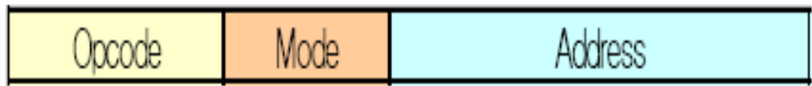
Instruction Formats
Fields in Instruction Formats
    Operation Code Field : specify the operation to be performed
    Address Field : designate a memory address or a processor register
    Mode Field : specify the way to determine operand or the effective address (Addressing Mode)
Instruction Format with mode field :

Slide 3
CPU organizations
The no. of address fields in the inst. format depends on the internal org. of CPU
3 types of CPU org.
  1) Single AC Org.
  2) General Register Org.
  3) Stack Org.

Slide 4
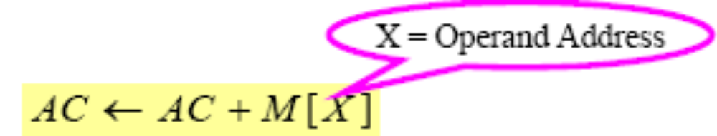
1) Single AC organization
ADD X
All operations – performed with an implied AC reg.
Computer uses one address field.

Slide 5
2) General Register organization
Employ 2 or 3 address fields.
Each address field specifies a reg. or memory word.
ADD R1, X
ADD R1, R2, R3
Reduce address field from 3 to 2 if the destination reg. is same as one of the source regs.
ADD R1, R2
Transfer type inst. : MOV need 2 address fields.
MOV R1, R2

Slide 6

3) Stack organization
Has PUSH and POP inst. : require an address field.
Operation-type inst. : not need an address field.
Operation is performed on the top 2 items.
Stack pointer is automatically updated.
PUSH X
ADD
  Pop 2 top no. from stack
  Add the nos.
  Push the sum into the stack

Slide 7
Intel 8080 Microprocessor
Most computers fall into one of the 3 orgs.
Some computer combine features from more than one org.
  Eg: Intel 8080 Microprocessor
    Has 7 CPU reg., one of which is an AC reg.
    Has some characteristics of AC, general reg. and stack type org.
    All A & L inst, LOAD and STORE inst.- use AC reg.
    These inst. have one address field.
    Transfer-type inst.- need 2 address fields.
    Has stack pointer and PUSH and POP inst but does not have 0-address inst.

Slide 8
Evaluation of arithmetic statement using 0, 1, 2, or 3 address instruction
X = (A + B)*(C + D)
  4 Arithmetic operations : ADD, SUB, MUL, DIV
  1 Transfer operation : MOV
    Transfer to and from memory and general register
  2 Transfer operation : STORE, LOAD
    Transfer to and from memory and AC register
  Operand memory addresses : A, B, C, D
  Result memory address : X

Slide 9
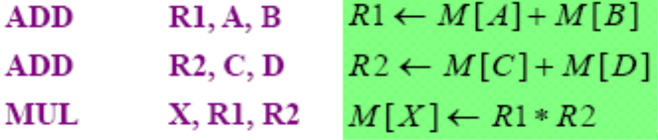
1) Three-Address Instruction
X = (A + B)*(C + D)
Each address fields specify either a processor register or a memory operand
Advantage: Short program
Disadvantage: Require too many bit to specify 3 address
Commercial computer: Cyber 170 uses this.

Slide 10
1) Three-Address Instruction cont..
.
.
.
CPU
Op1 Addr:
+
Add Res, Op1, Op2
(Res <- Op1 + Op2)
OP1
Op2 Addr:
OP2
Bits:
8
24
24
24
Res Addr:
Opcode
Res Addr
Op1 Addr
Op2 Addr
Res
Nexti Addr:
Program
Counter
24
Nexti

Slide 11
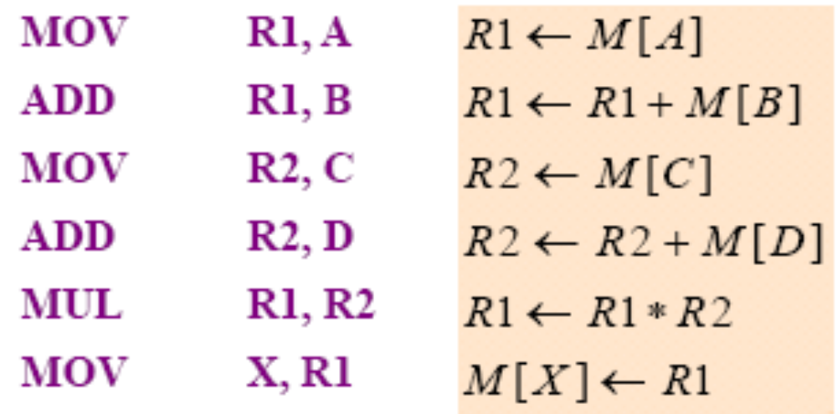
2) Two-Address Instruction
X = (A + B)*(C + D)
The most common in commercial computers
Each address fields specify either a processor register or a memory operand

Slide 12
2) Two-Address Instruction cont..
.
.
.
CPU
Add Op1, Op2
(Op2 <- Op1 + Op2)
Op1 Addr:
+
OP1
Op2 Addr:
Bits:
8
24
24
OP2, Res
Opcode
Op1 Addr
Op2 Addr
Nexti Addr:
Program
Counter
24
Nexti

Slide 13
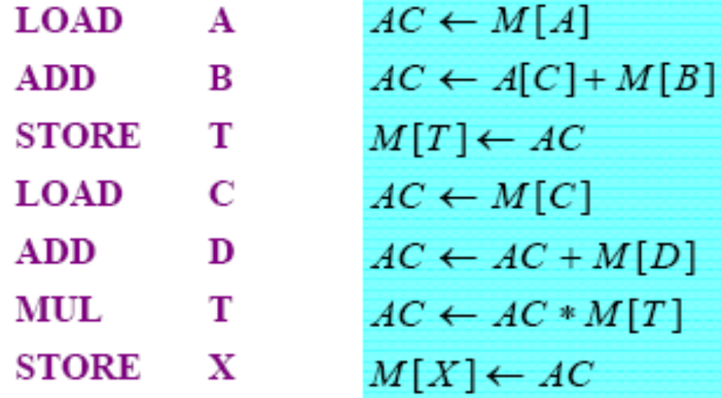
3) One-Address Instruction
X = (A + B)*(C + D)
Special CPU register, the accumulator, supplies 1 operand and stores result.
Use an implied AC reg. for all data manipulation
One memory address used for other operand.
All operations are done between the AC reg. and memory operand

Slide 14
3) One-Address Instruction
.
.
CPU
Add Op1
(Acc <- Acc + Op1)
Op1 Addr:
+
OP1
.
Bits:
8
24
Opcode
Op1 Addr
Accumulator
Nexti Addr:
Program
Counter
24
Nexti

Slide 15
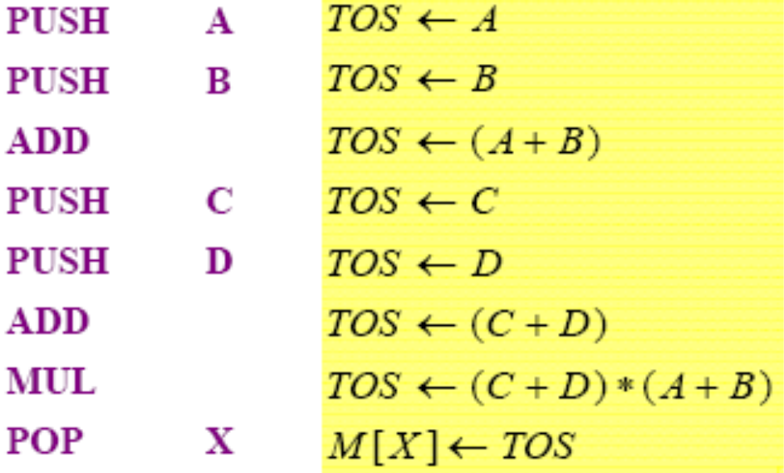
4) Zero-Address Instruction
X = (A + B)*(C + D)
Found in a stack-organized computer
  does not use an address field for the data manipulation inst.
  PUSH and POP inst. need an address field

Slide 16
push Op1
(TOS <- Op1)
Add (TOS <- TOS + SOS)
Bits:
8
Bits:
8
24
Opcode
Opcode
Op1 Addr
CPU
●
●
TOS
Op1 Addr:
OP1
●
+
TOS
SOS
Stack
Nexti Addr:
Program
Counter
24
Nexti

Slide 17
RISC Instruction
Reduced instruction set computer
RISC processor
  Only use LOAD and STORE inst.
    Transfer between memory and CPU
    Have 1 reg. and 1 memory address
  All other insts
    Executed within the registers of the CPU without referring to memory
    Have 3 addresses.

Slide 18
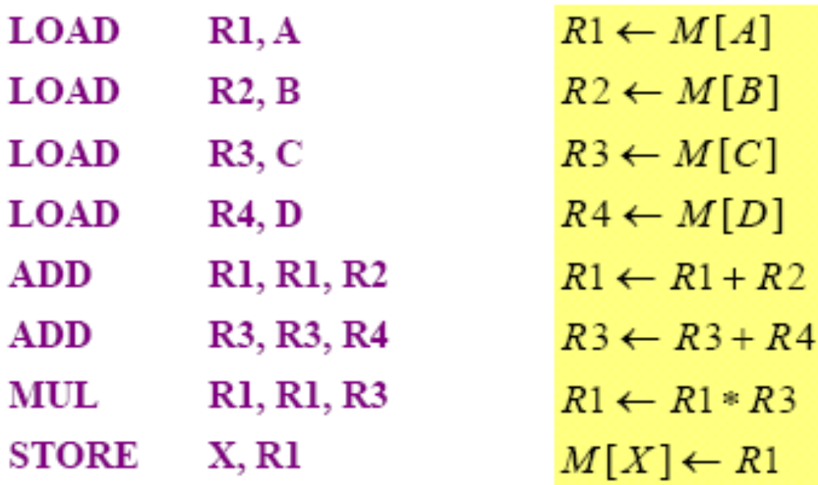
Program to evaluate X = ( A + B ) * ( C + D )

Slide 19
Problems
Evaluate a = (b+c)*d – e in 3-, 2-, 1-, 0- address machines and compute the memory traffic
3-address | 2-address | 1-address | 0-address
add a,b,c mul a,a,d sub a,a,e | load a,b Add a,c Mul a,d Sub a,e | Load b Add c Mul d Sub e Store a | Push b Push c Add Push d Mul Push e Sub Pop a
Memory traffic for 3-address
Machine: 7 * 3 = 21
Memory traffic for 2-address
Machine: 6 * 4 = 24
Memory traffic for 1-address
Machine: 3 * 5 = 15
Memory traffic for 0-address
Machine: 3 * 5 + 3 = 18

Slide 20
Assignment
Evaluate the expression a = b * c + d * e. (feel free to use a temporary variable, called, say T, if you feel you need one). Assuming that addresses are 16 bits, data values are 16 bits and opcodes are 8 bits, compute the size of your program in bytes and the amount of memory traffic the program would generate, in bytes. Compute the traffic due to instruction fetch and instruction execution separately.
The memory unit of a computer has 256K words of 32 bits each. The computer has an instruction format with four fields: an operation code field, a mode field to specify one of seven addressing modes, a register address field to specify one of 60 processor registers, and a memory address. Specify the instruction format and the number of bits in each field if the instruction is in one memory word.

Slide 21
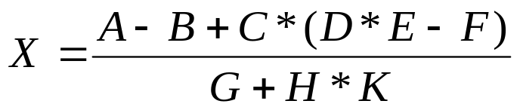
Assignment
A computer has 32-bit instructions and 12-bit addresses. If there are 250 two-address instructions, how many one-address instructions can be formulated?
Write a program to evaluate the arithmetic statement:
  Using a general register computer with three address instructions
  Using a general register computer with two address instructions
  Using an accumulator type computer with one address instructions
  Using a stack organized computer with zero-address operation instructions

Slide 22
Assignment
Assume an instruction set that uses a fixed 16-bit instruction length. Operands are 6 bits in length. There are K two-operand instructions and L zero-operand instructions. What is the maximum number of one operand instructions that can be supported?

Slide 23
Quiz
Number of bytes for 4-address instruction?
Number of bytes for 3-address instruction?
Number of bytes for 2-address instruction?
Number of bytes for 1-address instruction?
Number of bytes for 0-address instruction?

